Slide 1
Is “Moreyball” “Moneyball”?
A linear regression analysis on the most effective tactic available of the NBA basketball
Josh Jingtian Wang
Metis
2/22/2022

Slide 2

Backstory
Daryl Morey
Former Houston Rockets General Manager
First to apply advanced analytics to NBA scouting and training
Second most wins in the NBA during his tenure (2007-2020)
Moreyball:
Take more Layups, 3-pointers and free throw, less mid-range 2-pointers
Image: https://houseofhouston.com/

Slide 3
Backstory
01
02
03
04
CLIENT
QUESTION
The Houston Rockets front office
Does “Moreyball” lead to higher point differentials?
PURPOSE
DELIVERABLES
Revise coaching strategy and get more wins
A linear regression model to predict season net rating

Slide 4
Data Used
NBA Season Advanced Stats (2002-2022)
NBA Shot Location Data (2011-2022)
basketball-reference.com
basketball-reference.com
NBA Playtype Data (2015-2022)
nba.com

Slide 5
Methods
DATA ACQUISITION
BeautifulSoup and Selenium
DATA CLEANING AND MANIPULATION
Pandas
MODELING
Scikitlearn
Visualization
Matplotlib, Seaborn

Slide 6
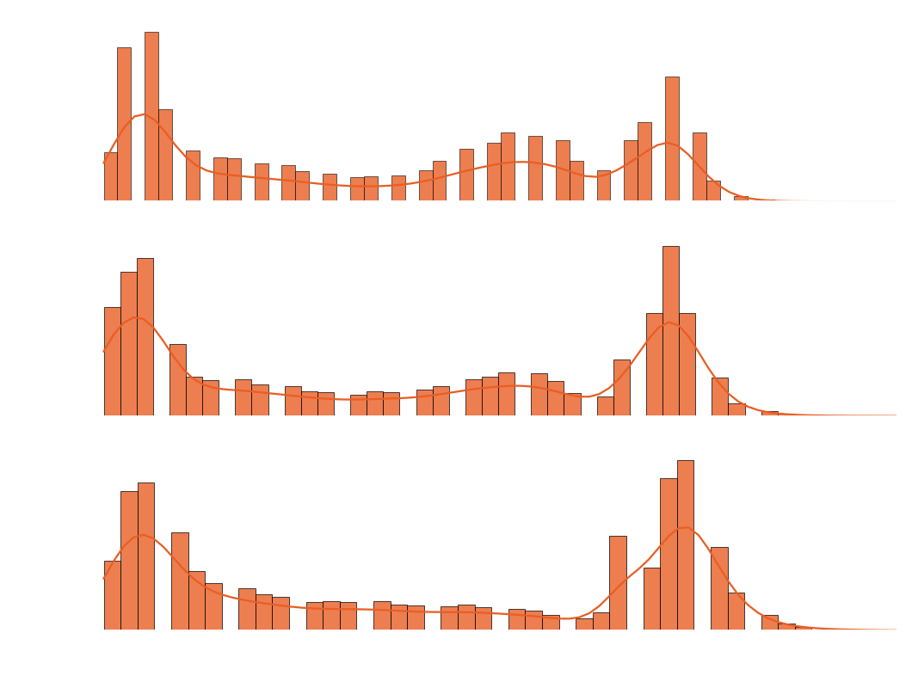
EDA:Shot Location Trend of the Past Decade
3-point line
Takeaway: the league has adopted “MoreyBall” in the last decade

Slide 7
Feature Examples
SHOT DISTANCE
REBOUNDS
DEFENSE
Layup, midrange, 3-pointer
Defensive, offensive
Steals, blocks
MOVEMENT
TEAMWORK
PLAYTYPE
Distance travelled, speed
Passes, assists
Postups, drives, etc.

Slide 8
Output Variable
NET RATING
an estimate of point differential per 100 possessions
To simplify the model: obtained feature differential if available.
e.g. rebound differential = team rebound – opponent rebound

Slide 9
Linear Regression Pipeline
Train/test split and scaled
(train=old seasons, test=new seasons)
Cross Validation (5 fold)
Regularization (Elastic Net)
Remove zero’d features, simple linear regression

Slide 10
Results
0.65
0.67
R² score on test set
R² score on test set
Elastic net:
1.65
Alpha: 0.02
L1 ratio: 0.09
1.60
MAE
MAE

Slide 11
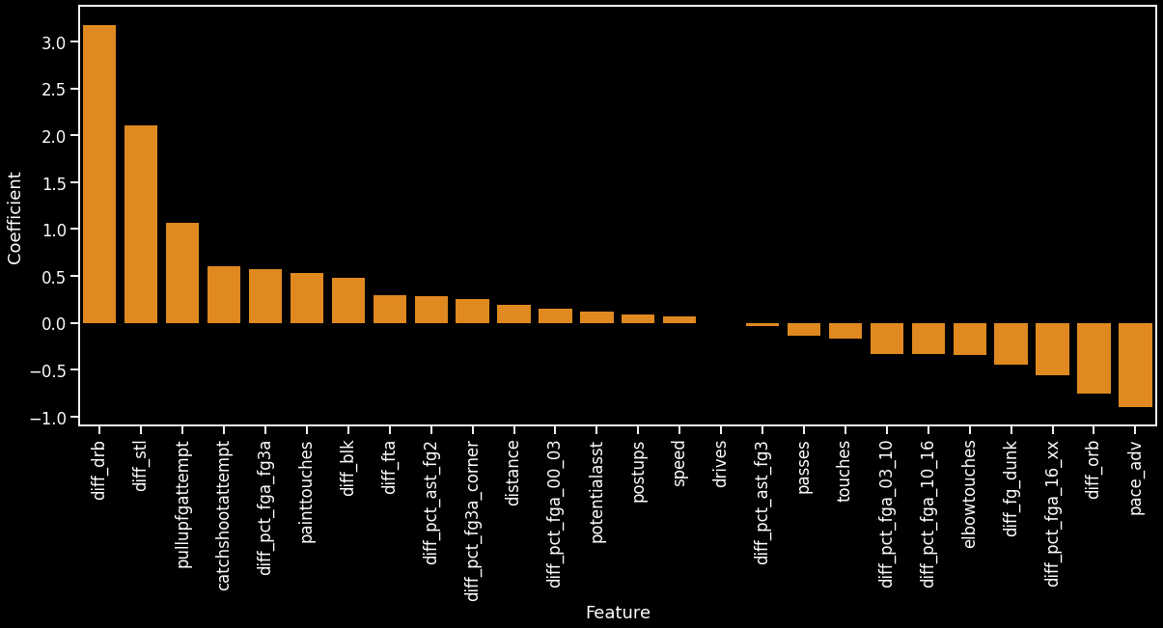
Coefficients after Regularization
defensive rebound differential
steal differential
3 pointer differential
long 2 pointer differential

Slide 12

The Importance of the Defensive Rebound (coef=3.17)
2020-21 season’s MVP race

Slide 13



PERFORMANCE
2022 Phoenix Suns
2022 LA Lakers
2022 New York Knicks
+7.45
-1.4
-1.5
Predicted net rating
Predicted net rating
Predicted net rating
+8.2
-1.23
+0.65
Actual net rating
Actual net rating
Actual net rating
Image: Daily Knicks, Getty Images, The Guardian

Slide 14

Conclusions
My model is able to predict the season net rating of an NBA team with the MAE of 1.60, based on the playstyle of the team.
“MoreyBall”’s shot selection philosophy is beneficial to the game, but not as important as defense
Here you give a brief intro of the topic you want to talk about. For example, you can talk about Mercury
Image: nba.com

